Slide 1
Quantum Error Correction
Philippe Noël, Alaisha Sharma, Nicolas Weninger
ES 170 Final Project
10 May 2018

Slide 2
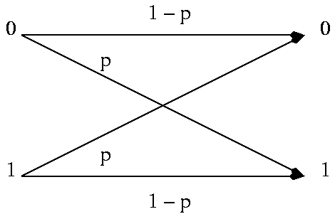
Basis in classical error correction
General idea
Message = bit sequence
Encoding
Detection
Correction / recovery
Binary symmetric channel
0 → 000
1 → 111
Small error probability p
Notes:
General idea
Message = bit sequence
Encode a message with some redundancy
Some of the message may be corrupted
Enough redundancy that original message is recoverable
Binary symmetric channel
0 → 000
1 → 111
Small error probability p means that only one bit likely to be flipped

Slide 3
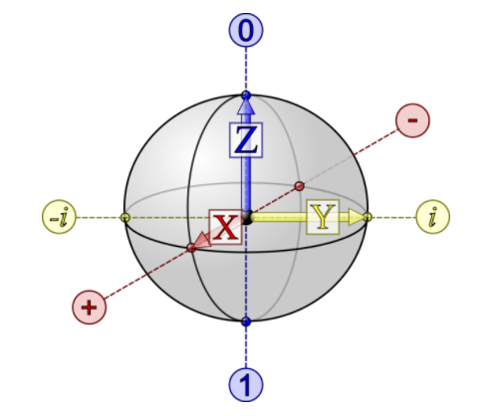
Challenges with quantum error correction
Ground Rules
No cloning of states
Errors are continuous
Measurement destroys information
Notes:
No cloning states
Repetition codes work for classical bits
Qubits cannot be replicated (would require looking at superposition)
Errors are continuous
Only bit flips can occur on classical bits
Continuum of different errors can occur on qubits (for example, rotating state by any amount)
Cannot determine exactly what error occurred (would require infinite resources)
Measurement destroys information
Can observe classical output before applying correction
Cannot observe (measure) quantum data without collapsing state

Slide 4
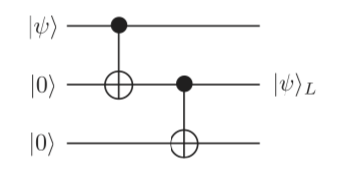

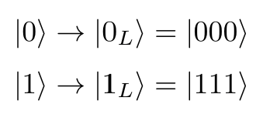
Encoding a logical qubit as 3 qubits
Single “logical” qubit mapped to three qubits
Quantum state is preserved
Redundancy introduced via duplication not repetition

Slide 5
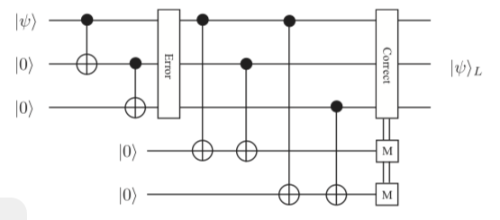
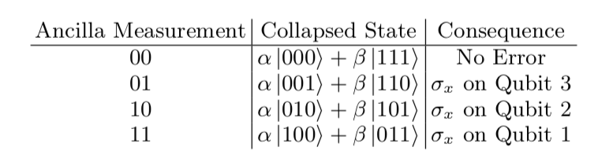
3-qubit error detection for bit flips
Notes:
We encode the state of the logical qubit as shown above, and then detect for a bit flip error using the ancillary qubits. This error detection scheme assumes that errors only occur after encoding (in other words, the encoding is perfect) and that any error is a single bit flip on exactly one of the non-ancillary qubits.
This circuit is identical to the one above, except we artificially introduce a bit flip error on each of the three non-ancillary qubits one at a time to show that the error detection is working correctly. An error on the first qubit will flip both ancillary qubits; an error on the second qubit will flip only the first ancillary qubit; and an error on the third qubit will flip only the second ancillary qubit.
Now in addition to detecting single bit flip errors, this circuit adds a set of gates that apply a corrective operation. Based on which ancillary qubits were flipped, we theoretically know exactly on which qubit the error occured. Therefore we can use CNOT gates to correct the second and third qubits (because only one ancillary qubit is flipped in either case) and double CNOT gates to correct the first qubit (because both ancillary qubits are flipped in this case).

Slide 6
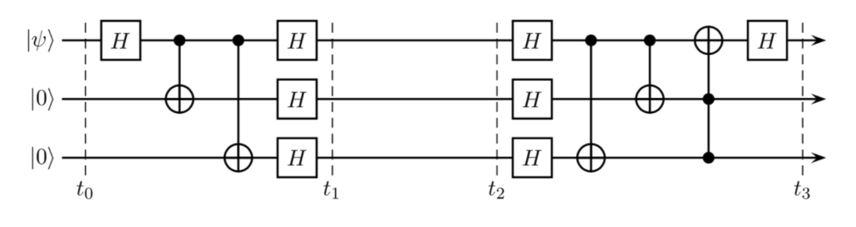
3-qubit error detection for phase flips
Notes:
We encode the state of the logical qubit as shown above, except apply a Hadamard gate first to create an arbitrary state. This is because a phase flip applied to the 0 state yields the 0 state again so it would be a trivial error. We then detect for a phase flip error using the ancillary qubits (a phase flip in the binary basis is equivalent to a bit flip in the Hadamard basis). Again this error detection scheme assumes that errors only occur after encoding (in other words, the encoding is perfect) and that any error is a single phase flip on exactly one of the non-ancillary qubits.
Now in addition to detecting single bit flip errors, this circuit adds a set of gates that apply a corrective operation. Instead of changing to the Hadamard basis and then applying a bit flip (X gate) we just apply a phase flip (Z gate) in the binary basis, so we can then use CNOT gates to correct the error. Based on which ancillary qubits were flipped, we theoretically know exactly on which qubit the error occured. The error correction process here is identical to the bit flip circuit, except we wrap each CNOT gate in Hadamard gates. This makes the gates behave like controlled Z gates.

Slide 7
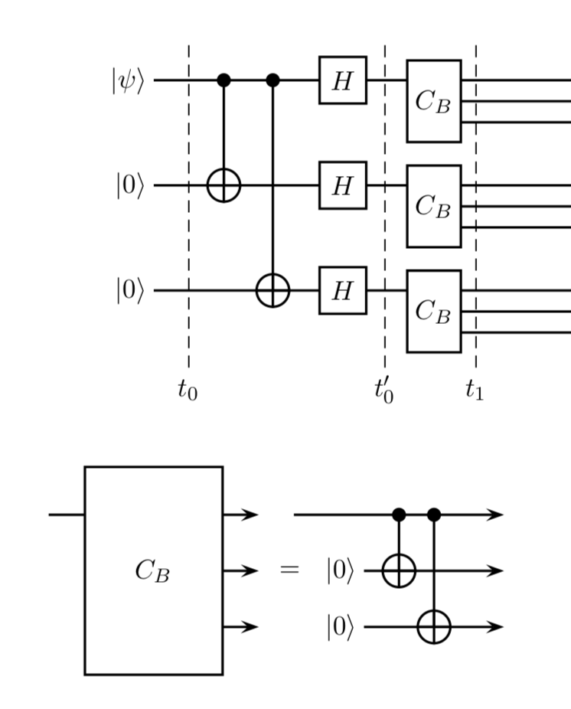
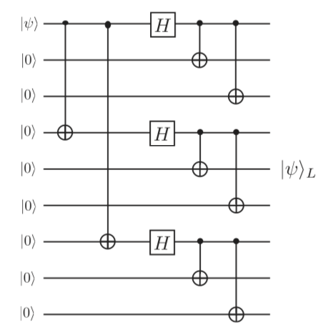
Encoding a logical qubit as 9 qubits

Slide 8
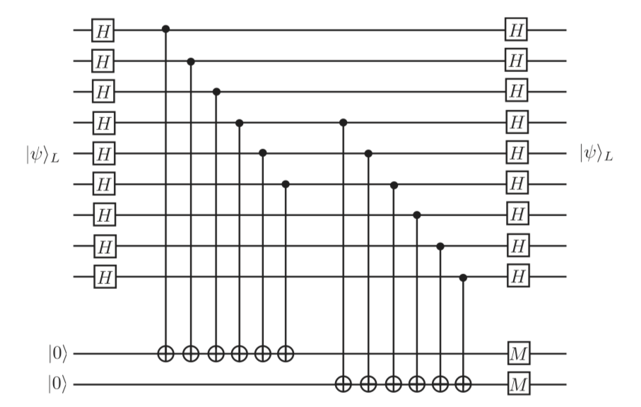
9-qubit error detection using ancilla qubits

Slide 9
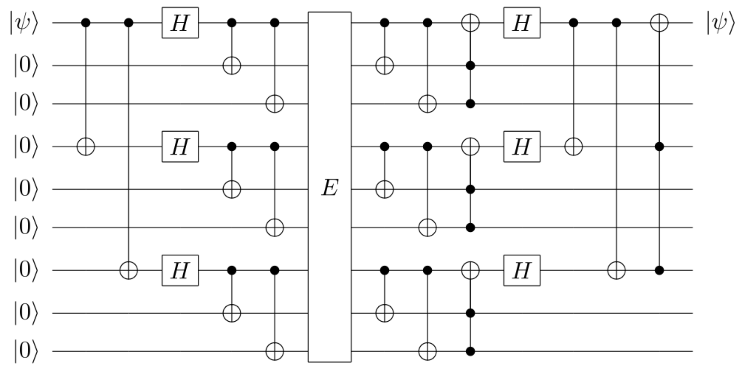
9-qubit error detection without ancilla qubits

Slide 10
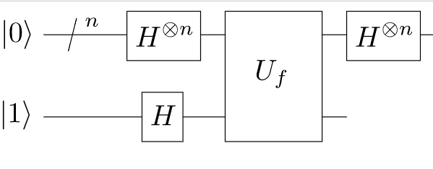
Error correction applied to Deutsch-Josza

Slide 11
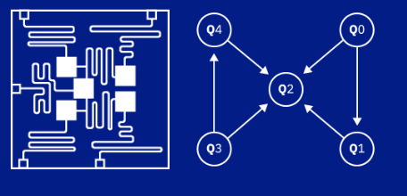
Quantum computing architecture

Slide 12
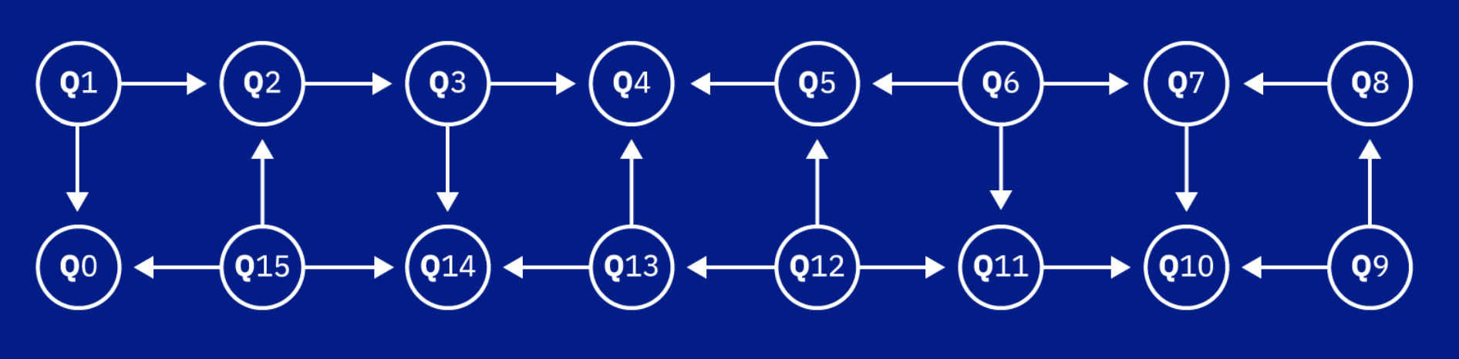
Quantum computing architecture

Slide 13
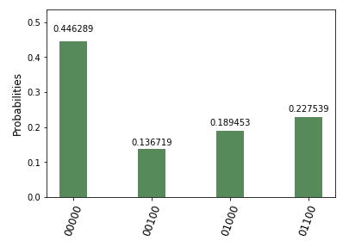
Modern error correction schemes
Assumptions
Perfect gate fidelity
Specific error-prone channel location
Only bit flip (X) and phase flip (Z) errors
Example: 3-qubit control circuit to detect bit flip (no errors introduced) run on IBMQ.
expected state
quantum “noise”

Slide 14
Modern error correction schemes
Solution: Stabiliser Codes!
σ_{z} |0⟩ = |0⟩
Generalisable to topological error correction codes in 2D

Slide 15
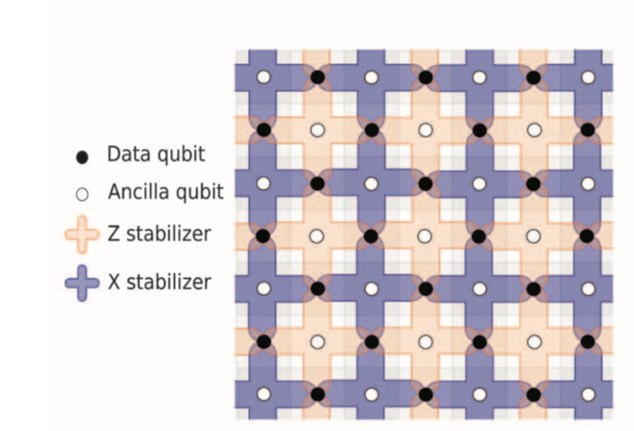
Surface code for bit and phase flips

Slide 16
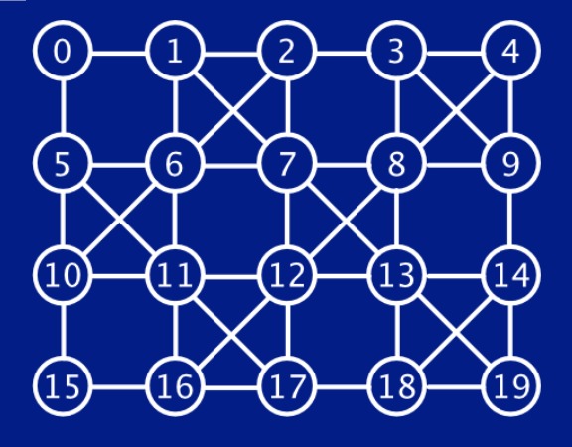
Looking ahead

Slide 17
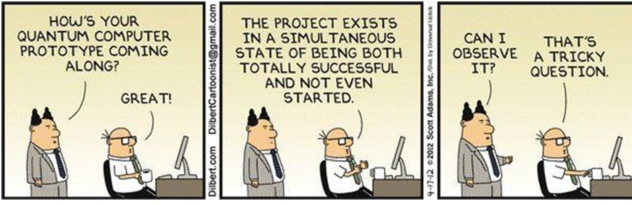
Thank you ES 170!

